Slide 1
CST 4562 COURSEWORK
Design and Implementation of a Secure, Scalable LAN Infrastructure for MSS Ltd: Network Architecture, Vulnerability Assessment and Security Recommendations
BY
JOHN ASHIS ROY
ZHIJIE XIE
BOON SUNI
ADAM PETER
GUL KHALID KHAN I

Slide 2
Overview
Our esteemed client, M/s MSS Ltd, has entrusted us with the task of laying out a project feasibility report, that includes recommendations on improving existing networking infrastructure at the company facility and if required, suggestions on acquiring additional hardware or software, as deemed fit to meet the organizational goals.
They expect us to provide all possible inputs in the design and implementation phase of the project, in order for them to achieve the objectives defined for the endeavor. Additionally, we have been asked to observe a project handover period of 30 days, post-design and implementation, that will be mandatory for us to attain a sign-off form from the customer.

Slide 3
Present Scenario
Customer is using legacy devices that lack modern security and on-board encryption services. Devices have reached EOS(End Of Sale), which means they are no longer available in the market; no additional spares can be ordered if required. Additionally, they are well beyond EOS(End of Support), which makes them in-eligible for limited Warranty and TAC assistance needed in case of network outage. The IT team is concerned that their devices have breached their EOL(End Of Life), and therefore vulnerable to system failures.
Network performance is degrading on a frequent basis, whereby users are often getting disconnected from the network and causing undesired productivity losses for the company.
Current network has Scalability issues, wherein additional users cannot be accommodated into the existing setup, without compromising the quality of network connectivity.
Maintenance and system upgrades are unavailable leading to data corruption and data recovery overheads.
Redundancy is currently not incorporated into the existing network, causing severe broadcast storms and bottlenecks in most parts of the network.
Power-Over-Ethernet(POE): Devices, such as IP Phones, printers and biometric scanners are frequently going offline. This was later found out to be due to insufficient POE power delivered by the switches.

Slide 4
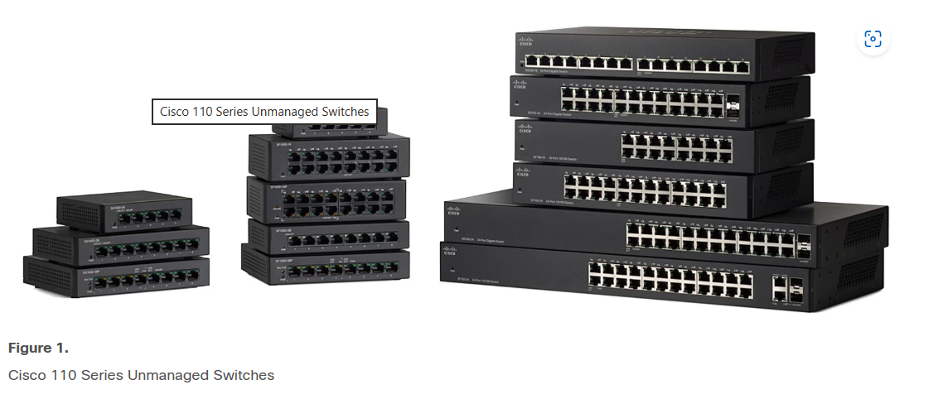
Present Scenario
Management & Telemetry: Because customer uses plug and play devices, there is no CLI or Web GUI to configure, monitor or troubleshoot settings interactively.
Additionally, there is no scope for remote management using tools like SSH, Telnet or advanced SNMP configurations.
Network Security is currently ignored by the existing setup, wherein crucial aspects such as segmentation, port aggregation and loop detection given least importance.

Slide 5
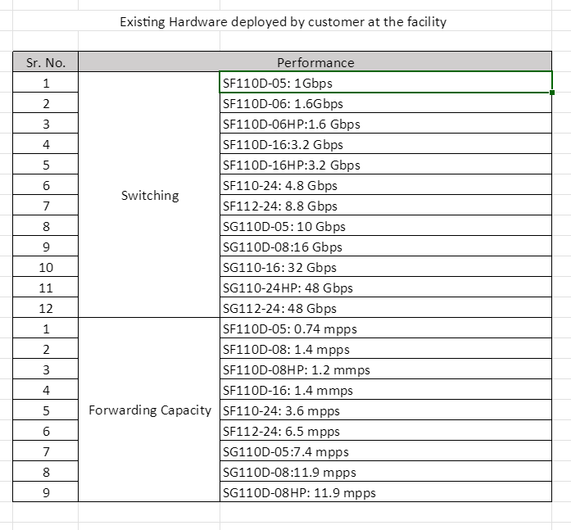
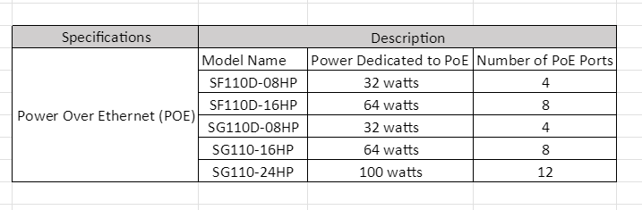
Challenges
Bandwidth / Throughput
Power-Over-Ethernet

Slide 6
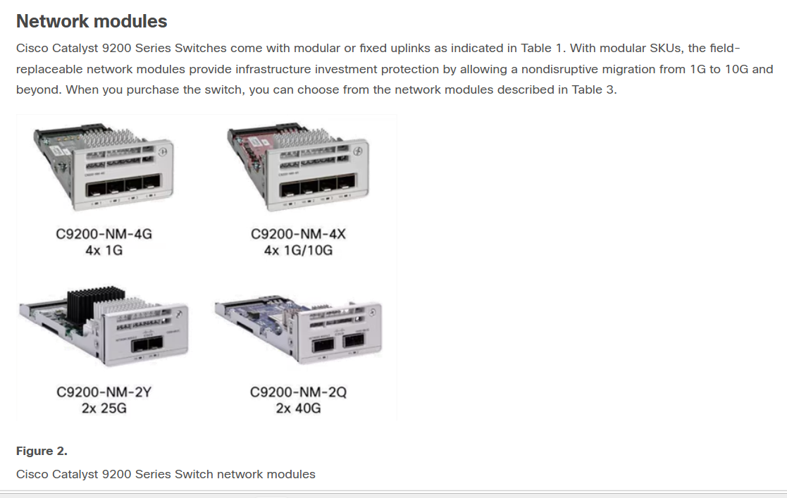
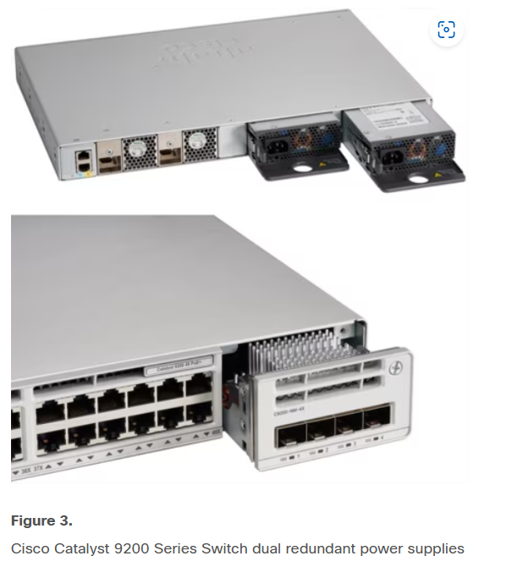
Solutions

Slide 7
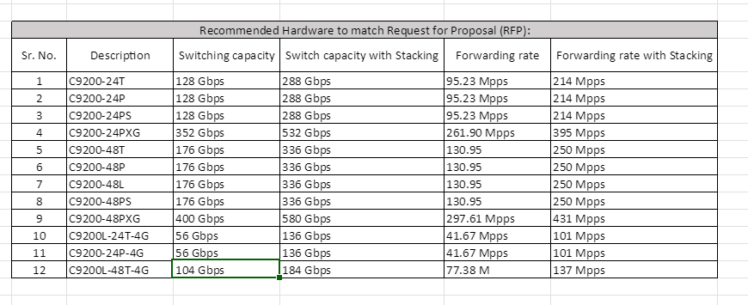
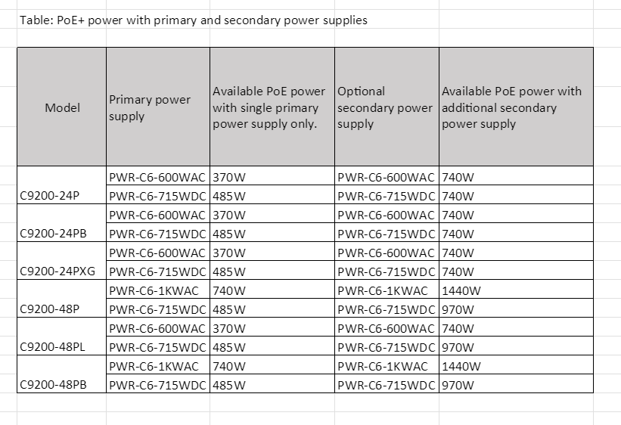
Benefits Of Stacking
Simplified Management: A stack of switches can be managed as a single entity with a single IP address, reducing administrative overhead compared to managing individual switches.
Increased Performance and Bandwidth: Stacking aggregates the backplane bandwidth of individual switches, providing higher inter-switch communication speeds and overall network throughput. Cisco C9350 Smart Series switches offer up to 1.6 Tbps of stacking bandwidth.
Enhanced Redundancy and High Availability: If one switch in the stack fails, other members can seamlessly take over its functions, minimizing network downtime.
Scalability: Network capacity can be easily expanded by adding more switches to the stack as needed, up to the maximum supported members.

Slide 8
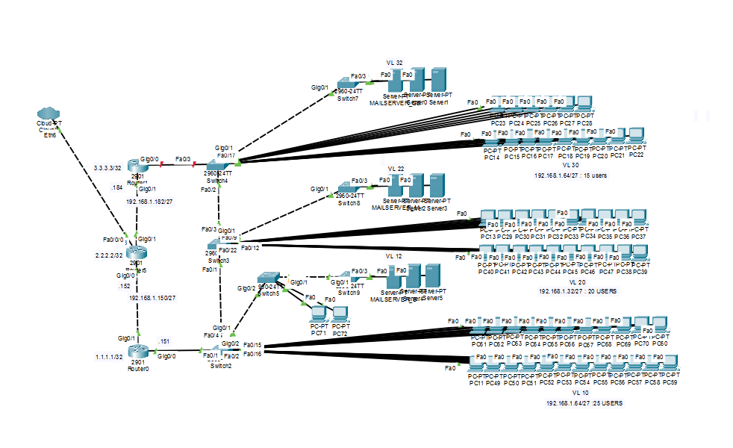
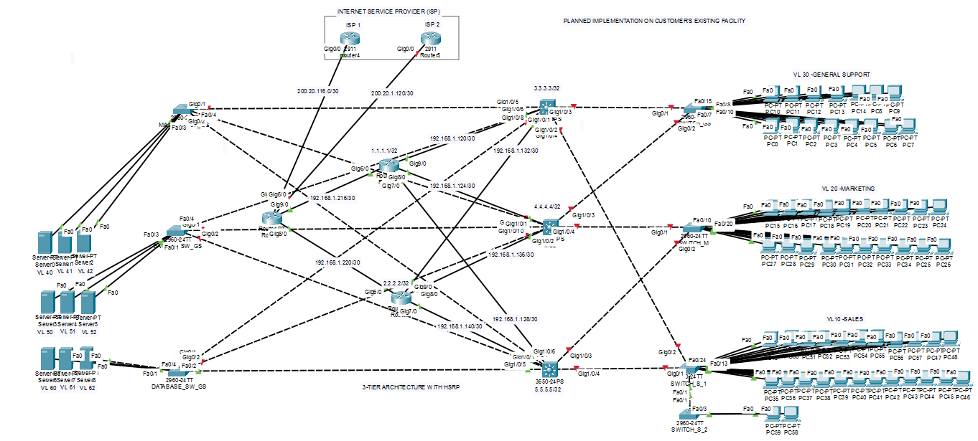
Architectures Comparison
Existing Network Architecture (OUTDATED) 10 DEVICES
3-Tier Architecture (UPDATED)
13 DEVICES
Suggested Additions: C3650 -3 Nos

